Slide 1
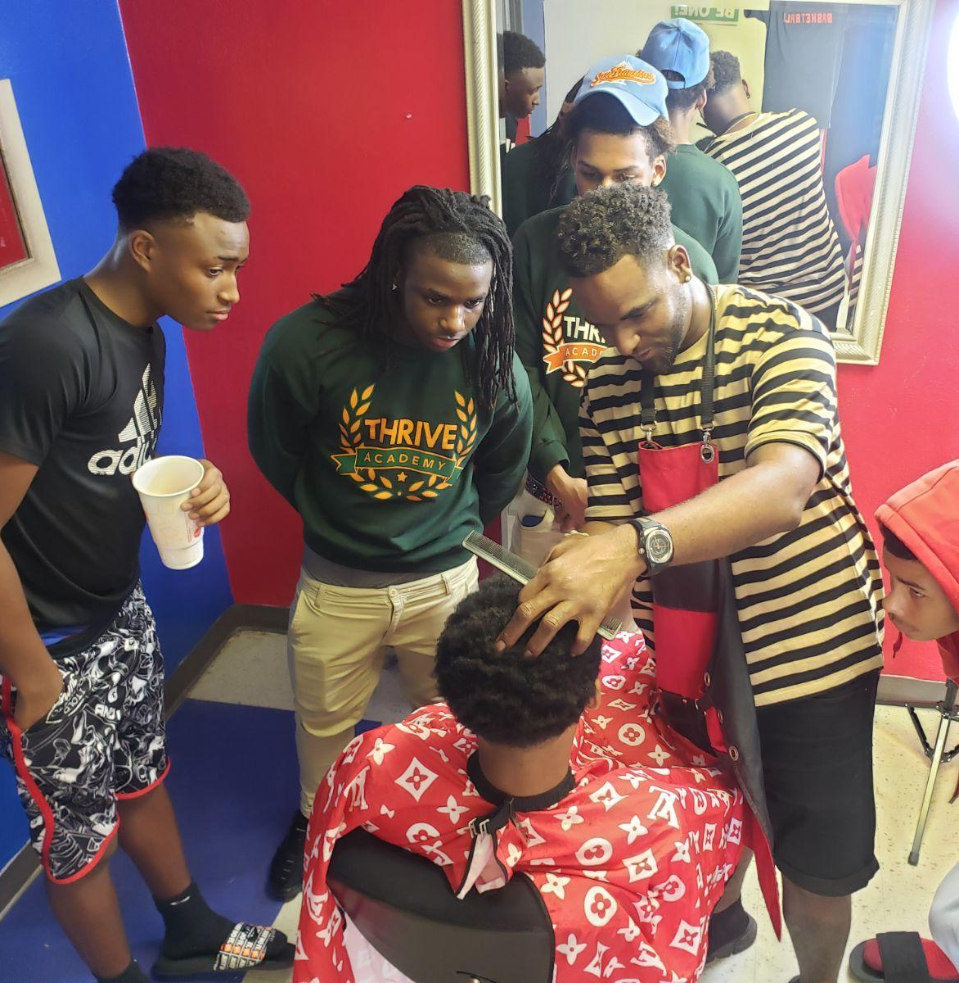
HIGH SCHOOL BARBERING
O’Neil Curtis
Line4Line
O’Neil’s Barber & Beauty Salon
449 N. Acadian, Baton Rouge, LA 70806
225/954-7771

Slide 2
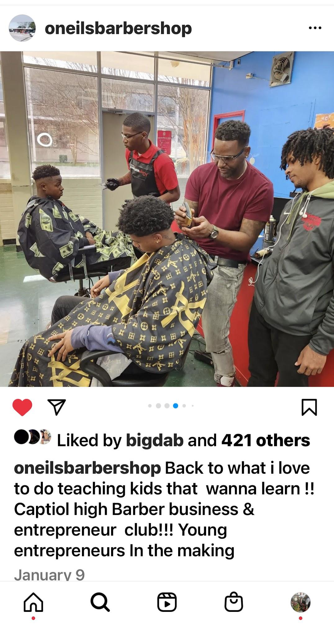
ABOUT THE PROGRAM
O’Neil Curtis is a graduate of Glen Oaks High. He is Successful small business owner, master barber, nonprofit director, and community mentor.
O’Neil is a licensed Master Barber and Licensed instructor with over 20 years of experience teaching teen and adults, and providing apprenticeships. So far, he has placed 23 students into successful careers.
Line4Line is a youth development nonprofit focused on literacy and youth development.
High School Barbering started in 2020 at Capitol High and was a great success with students and staff. Over the past three years we have taught over 250 students. Program partners include: Capitol High; Thrive Academy; Louisiana National Guard Youth Challenge Program.
Our program combines Direct instruction, Hands on Learning, Practical Life and Work skills.

Slide 3
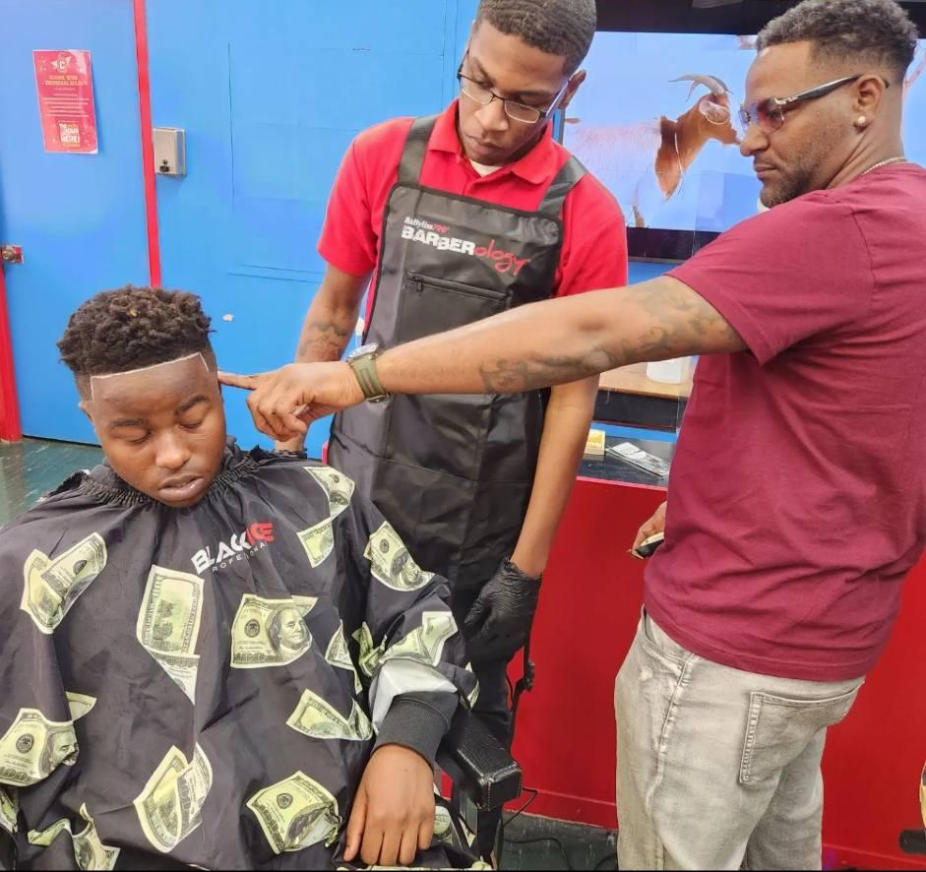
GOALS AND OBJECTIVES
To introduce students to the art and business of barbering through hands on learning and relatable mentoring.
To teach a Lucrative vocation that can lead to a lifelong career.
To introduce students to practical entrepreneurship and business skills.
To increase student’s academic motivation
To empower students as successful learners
To provide scholarships to support continued barber education
To provide paid apprenticeships.
To provide mentoring resources and support.

Slide 4
PROGRAM OVERVIEW
The curriculum introduces students to barbering skills and entrepreneurship through hands on learning.
O’Neil’s role as a relatable mentor, successful business owner, entrepreneur and master barber combined with his genuine rapport engages young people in learning .
Program suited to male and female students.
Program model can be expanded to serve middle school students; and can be configured into different formats.
Instructor’s availability on Mondays, Tuesdays, and Wednesdays.
The program is offered in a variety of formats to work with your schedule - 1) embedding into the academic day ; 2) As a regular elective; 3) as afterschool / out of schooloption; 4) as a special drop in program.

Slide 5
OUTCOMES
The Ron Brady Scholarship
awarded to 3 Capitol high Students in 2023

Slide 6
Program Cost:
Line4Line’s High School Barbering Program is funded in part by grants and in-kind donations.
Line4Line Provides:
Barber chairs and mirrors
Instructional tools, clippers, etc.
scholarships & aprenticeship awarded annually to top students
School/Partner Provides:
a space for the program.
Instructor Fee: $200 per program.

Slide 7
THANK YOU

